Slide 1

March 12th, 2016

Slide 2

Exploratory Data Analysis
with
Abhishek Roy | March 12th, 2016

Slide 3
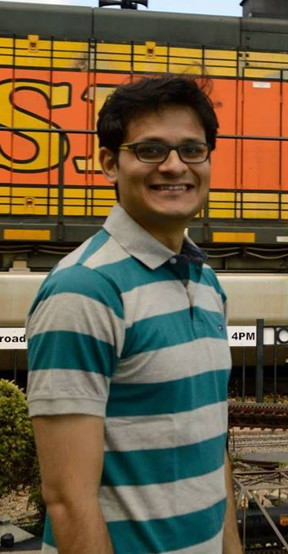


About Me
Analytics Consultant , Fractal
Analytics
Consult Fortune 500CPG -Retail Clients
Co-Founder of Social Data Science
Crowd-sourced Data Science for Nonprofits
https://www.linkedin.com/in/abhishekkroy
https://github.com/nonchalantroy
@AbhishhekRoy

Slide 4

Agenda
Quick intro to R Studio
Review of the college dataset
EDA using R
Small Group Mingle

Slide 5
Quick Intro to R Studio
R is an object oriented, statistical
programming language
Rstudio* - A well designed integrated development environment(IDE) for R.
Easy to Use
Helpful for new users as the text editor employs some chromatic and other formatting techniques not present in the R environment
More traditional menu-driven options for data-loading and package installation and loading
* RStudio requires R to be installed on a machine first. RStudio currently requires R 2.11.1 or higher.

Slide 6
Quick Intro to R Studio
Step 1: Download and install R. http://cran.r-project.org/ (Links to an external site.)
Step 2: Download and install RStudio. http://www.rstudio.com/products/rstudio/download/ (Links to an external site.)

Slide 7
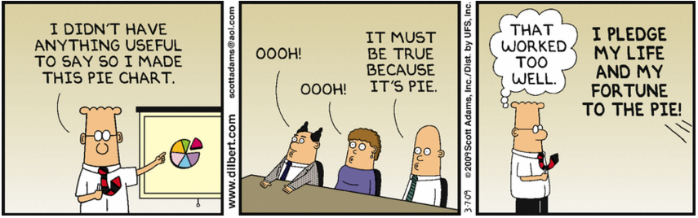
Why EDA?

Slide 8
Why EDA?
Beware of Misuse of Statistics
54% of all statistics are made on spot
Spurious Correlations
Graphical techniques helps in making some general observations about the shape and spread of data
A more complete understanding of the data can be attained by summarizing the data using statistics
Helps us in framing the hypothesis we want to test

Slide 9
EDA with R

Slide 10
Where to go from here?
Pick up any data and perform this exercise yourself!
The code and presentation will be shared on github

